Slide 1
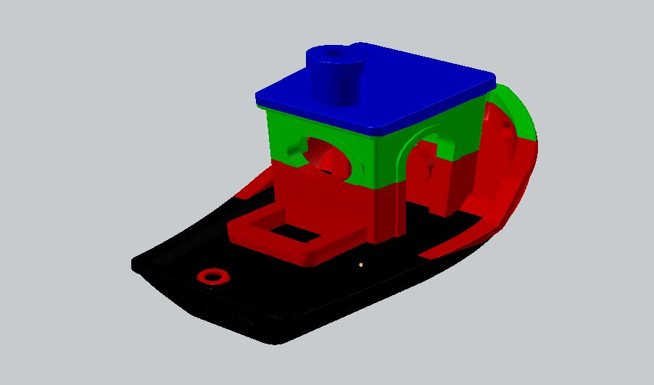
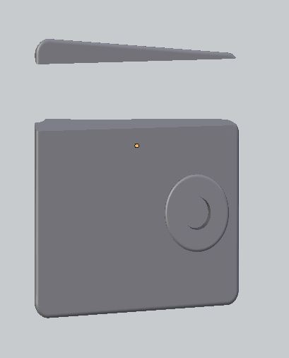
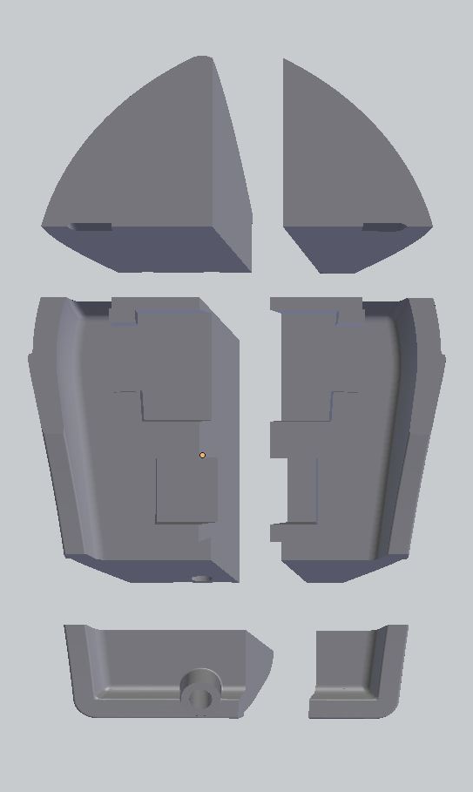
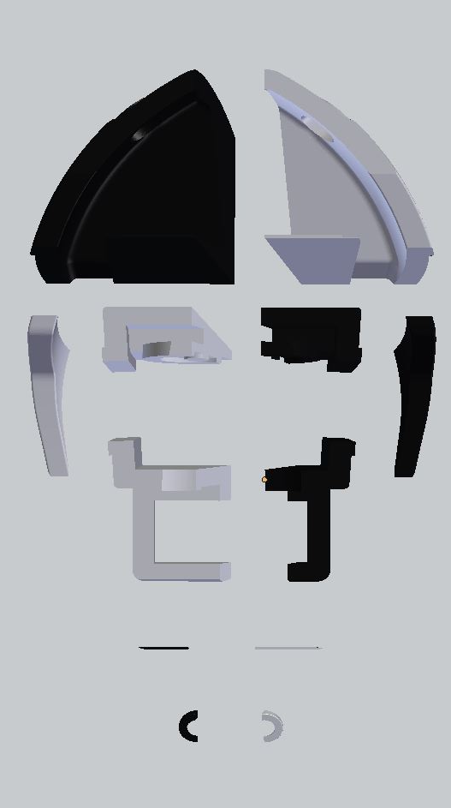
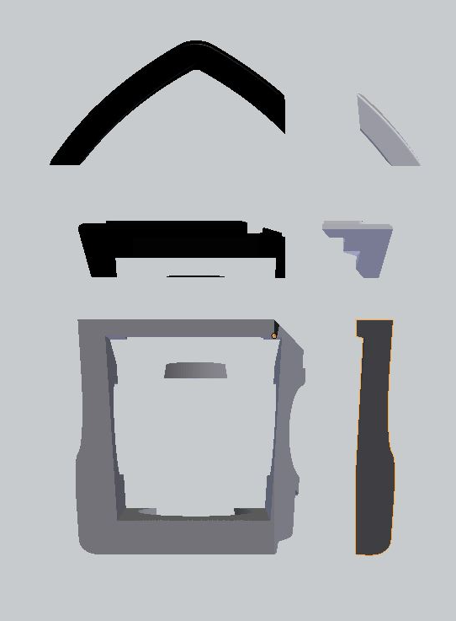
C 0:
1139
C 1:
81
(E) Chunk Configuration
Layer 3
(A) Resized 3DBenchy Layers
C 0:
1152
C 1:
655
C 0:
1075
C 1:
722
C 0:
729
C 1:
86
C 2:
2039
C 3:
1496
C 2:
716
C 3:
564
C 2:
561
C 3:
146
C 4:
561
C 5:
217
C 4:
8
C 5:
8
(D) Chunk Configuration
Layer 2
(B) Chunk Configuration
Layer 0
(C) Chunk Configuration
Layer 1

